Slide 1
Kensington and Chelsea Citizens’ Panel – Culture
Consultation report and findings written in January 2026
Consultation and Participation Team​
The Royal Borough of Kensington and Chelsea​
consult@rbkc.gov.uk

Slide 2
Introduction
​Background
This consultation sought to understand views on the Council's current offer of cultural activities and explore what stakeholders believe should be priorties in the new Culture Plan. Given the breadth of this work, multiple activities took place including a survey with our Citizens’ Panel, a publicly available survey, sector engagement workshops, a session with Kensington and Chelsea’s Youth Council and an in-person event with approximately 97 Citizens’ Panel members. Details of these activities can be found in this report. The feedback from this consultation, will help shape priorities for investment and partnerships, so that cultural opportunities remain diverse, valued, and impactful across the borough.
The Citizens’ Panel is a large, demographically representative group of residents from across the borough who are regularly invited to give public preferences and opinions to inform Council decision-making. The Panel was launched in April 2021.
Methodology and report​ing of the survey
The Panel survey on Culture Activities in Kensington and Chelsea launched in September 2025 and was accompanied by an open to all public survey. The survey is seeking residents’ views on the cultural activities currently available in Kensington and Chelsea to understand whether they meet local needs and interests. The aim is to ensure future cultural services are inclusive, accessible, and support community cohesion, while making the best use of limited budgets.
The survey was developed with the Director for Grenfell Partnerships and Community Transformation, as well as Deputy Leader and Lead Member for Employment, Culture and the Economy. Both surveys were launched on 10 September 2025. This was emailed and texted to all Citizens’ Panel members with some Panel members opting to receive the survey via post with a freepost returns envelope for returning the survey. Four subsequent reminder emails and two reminder texts were sent to encourage Panel members to complete the survey. The public survey was shared via partner organisations and via our communities' newsletter.
The survey closed on 23 October 2025 and a total of 488 completed surveys were received, 370 from
the Citizens Panel and 118 from the public.

Slide 3
Introduction
A form of AI called large language models (LLM) was used to assist theming comments made in the survey. All comments received have been read by a Council officer who also reviewed and amended themes where needed. The LLM is accessed through Azure Open AI - no data is shared with external entities, and no data is used for future training of large language models (LLM). ​
Appendices
The appendices report contains the data tables of results and the details of all themed comments made by respondents in relation to the consultation, it also contains the full write ups from the events and workshops. All other responses and data are in the report. The appendices report is available upon request.
Equalities
Throughout the report responses have been analysed for any key demographic differences. Responses to questions have been compared by sex, age, ethnicity and area lived in and differences of five per cent or more have been reported on. The report also contains year on year comparisons.
Equalities data is presented in the ‘About Respondents: Demographic Breakdown’ section and is used throughout to identify any differences in opinion. Please note, the split in age ranges used is limited to those under 60 compared to those over 60 due to the small number of responses from Panel members under 35 so it was not possible to make any further breakdowns meaningful.
For information, the area breakdown used throughout is as follows:
North – Dalgarno, St Helen’s, Notting Dale, Colville, Norland and Pembridge
Centre – Holland, Campden, Abingdon, Queen’s Gate, Earl’s Court, Redcliffe and Courtfield
South – Brompton and Hans Town, Stanley, Chelsea Riverside and Royal Hospital
Acknowledgements​
The Council would like to thank everyone who took the time to take part in the exercise and gave
their views.

Slide 4
Survey Results Citizens’ Panel and Public Survey Combined

Slide 5
Summary of survey findings
Current provision of cultural activities – Respondents most commonly participate in restaurants and cafés (75 per cent), museums (74 per cent), and cinema/film and art and design (both 62 per cent). The activities residents would most like to see more of are theatre (51 per cent), followed by art and design and cinema/film (both 46 per cent), and community events and music (both 44 per cent). Kensington Central Library and Portobello Road Market are the most valued cultural services, each valued by 80 per cent of respondents.
Improving experience of culture in the borough and the Council’s role – Free‑text responses highlighted three main priorities: improving promotion and accessibility of cultural activities (165), expanding and diversifying cultural events and the use of public spaces (94), and increased support for local artists, venues and heritage (57). Respondents most strongly supported the Council promoting events through its communication channels (84 per cent), supporting markets and community events (78 per cent), and funding additional street cleaning and security after large events (75 per cent).
Value of cultural activities – There is strong agreement that culture adds enjoyment to residents’ lives (85 per cent agree), that cultural activities should be encouraged by the Council (83 per cent) and supports learning (79 per cent). Respondents also strongly agreed that cultural activities help bring communities together (81 per cent) and support inclusion by enabling people to meet others from different backgrounds (81 per cent).
Prioritising future cultural activities – Respondents were given free space to share which cultural activities they believe the Council and its partners could do to improve their experience of cultural activities in the borough, when themed, the three most common topics are, Council run services including libraries, parks and museums (151), community and grassroots cultural activities (136) and cultural venues, institutions, and arts (127).
Supporting community cohesion – Respondents were also given free space to share what more they think the Council can do through cultural actives to support community cohesion, when themed, the three most common topics are, inclusive and diverse cultural programming (51), scepticism of Council’s role and cultural activities (40) and promotion, communication, and awareness (40).

Slide 6
Types of cultural activities
When asked what type of cultural activities respondents get involved in in Kensington and Chelsea, the most common cultural activities are restaurants and cafés (75 per cent), followed by museums (74 per cent), and cinema and film and art and design (both 62 per cent).
Just over half of respondents report involvement in markets (58 per cent). Around half of respondents report involvement in theatre (47 per cent), music and libraries (both 45 per cent), while 39 per cent report involvement in community events.
Lower levels of involvement are reported for festivals (34 per cent), the night-time economy (30 per cent), sports (25 per cent), Notting Hill Carnival (24 per cent), fashion (17 per cent) and other activities (8 per cent). A graph with the full results can be found on the next page.
Eight per cent selected other, the comments made have been themed and those mentioned four or more times are listed in the table below. The full list of comments is available in the appendix report.
Theme | Count
Music and Arts | 19
Outdoor and Active Activities | 11
Poetry | 10
Community Centres and Volunteering | 6
Religious Activities | 6
Educational Activities | 5
Council Events and Exhibitions | 4

Slide 7
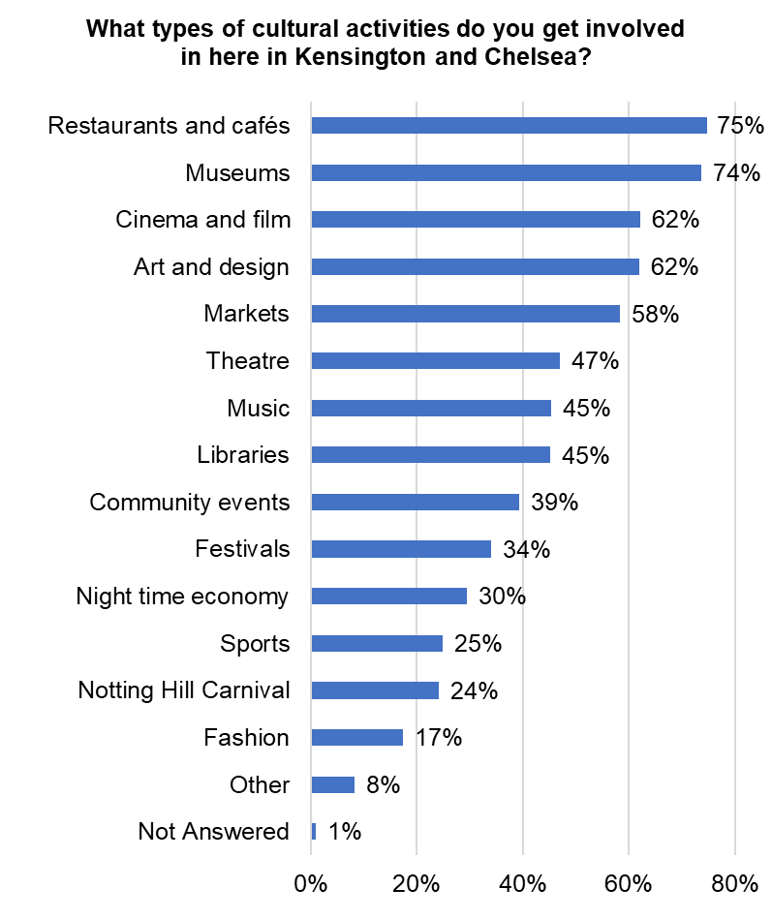
Types of cultural activities
Base: 488 (all responses)

Slide 8
More or less cultural activities
The cultural activities respondents would most like to see more of are theatre (51 per cent), followed by art and design and cinema and film (both 46 per cent), and community events and music (both 44 per cent). Libraries were selected by 42 per cent of respondents, while markets by 38 per cent and festivals by 30 per cent.
The activities respondents would most like to see the same amount of are restaurants and cafés (52 per cent), sports (50 per cent), fashion (47 per cent) and the night-time economy (46 per cent).
A preference to see less of is highest for Notting Hill Carnival (36 per cent), followed by the night-time economy (15 per cent) and festivals (11 per cent). A graph with the full results can be found on the next page.
Respondents were given space to share any other cultural activities they would like to see more of less of in the borough. A total of 141 people gave an answer, the comments made have been themed and listed in the table below. Examples of the comments made can be found on the page after the graph and the full list of comments is available in the final appendices report.
Theme | Count
Enhancement and Expansion of Arts and Cultural Exhibitions | 51
Support for Community, Multicultural, and Cross-Cultural Events | 50
Promotion of Faith, Heritage, Historical, Environmental, and Nature-Related Cultural Activities | 21
Expansion of Cultural Education, Workshops, and Specific Cultural Themes | 17
Increase in Youth, Family, and Older Generation Cultural Activities | 15
Difficulty with survey formatting or no further comment | 12
Support for Nightlife, Entertainment, Local Food, Markets, and Independent Businesses | 12
Improvement of Accessibility, Inclusivity, and Representation in Cultural Activities | 11

Slide 9
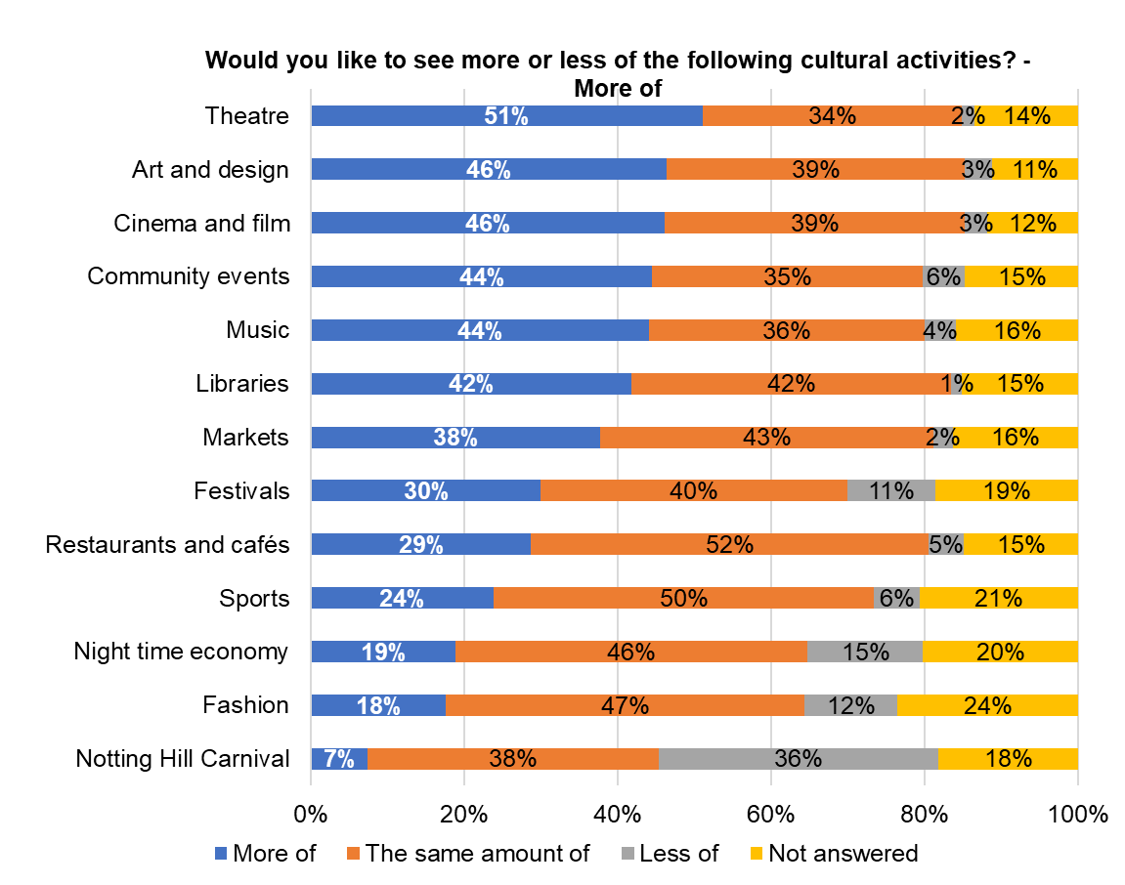
More or less cultural activities
Base: 488 (all responses)

Slide 10

More or less cultural activities
“I would like to see more youth-led cultural events, Afro-Caribbean cultural events, and more outdoor concerts for families.”
Increase in Youth, Family, and Older Generation Cultural Activities
“More of Opera live theatre Street markets. Less of outdoor pub and restaurant spaces and fake flower displays.”
Enhancement and Expansion of Arts and Cultural Exhibitions
“More support for night time economy. This seems to have really declined in the Notting Hill & North Kensington areas.
More support for live music.”
Support for Nightlife, Entertainment, Local Food, Markets, and Independent Businesses
“More Community events. I think the area became very touristic and gentrified and in need of more community events to gather and unity residents going a more ample sense of community.”
Support for Community, Multicultural, and Cross-Cultural Events
“More information on the hidden secrets of the borough, history walks and gatherings / walks. I went on the Art Bus run by Muse Gallery and Kensington and Chelsea Art week and that was a great discovery .”
Promotion of Faith, Heritage, Historical, Environmental, and Nature-Related Cultural Activities
“More that are accessible for disabled people and local people.”
Improvement of Accessibility, Inclusivity, and Representation in Cultural Activities
“Teaching courses, for instance languages, especially English language. Also, more teaching courses like sewing, computers, etc.... the borough is very poor with adults education.”
Expansion of Cultural Education, Workshops, and Specific Cultural Themes

Slide 11
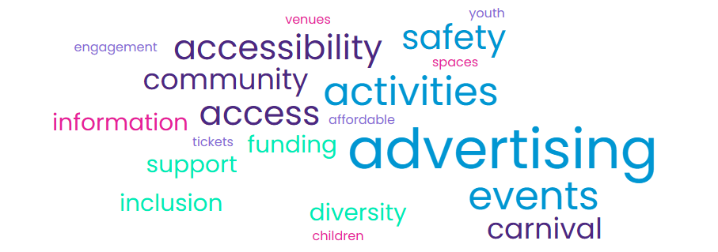
Improving your experience of cultural activities
Respondents were asked what is the one thing they believe the Council and its partners could do to improve their experience of cultural activities in the borough.
A total of 349 people provided responses. These comments have been grouped into key themes, which are summarised in the table on the next page with a word cloud included below as a summary.
Examples of individual comments are included on the page after, with the full list available in the final appendices report.

Slide 12
Improving your experience of cultural activities
Theme | Count
Enhance Promotion and Accessibility of Cultural Activities: Residents seek improved advertising, communication, and affordability of cultural events to increase awareness and participation across diverse groups including disabled, elderly, children, and low-income individuals. | 165
Expand and Diversify Cultural Events and Use of Public Spaces: There is call for a wider variety of cultural events such as concerts, festivals, theatre, film, and markets, utilising outdoor and public spaces including parks, streets, and vacant buildings for inclusive activities. | 94
Support and Invest in Local Artists, Cultural Venues, and Heritage: Funding, grants, mentorship, and infrastructure improvements are called for to strengthen local artists and venues, alongside investment in historic buildings and collections to preserve local history and culture. | 57
Improve Safety and Cleanliness: Enhanced lighting, police presence, CCTV, cleanliness, and overall safety to create a better environment for cultural participation. | 26
Manage Large Cultural Events and Address Community Concerns: Large events require better management, possible relocation or size reduction, and mitigation of noise, environmental, and transport disruptions, with some opposition to high cultural spending and event impacts. | 23
Neutral or Unclear Views on Cultural Activities: Including some respondents who think the Council should not spend in this are. | 17
Improve Community Engagement: Better coordination with local groups are essential to create a safe, welcoming, and socially cohesive environment for cultural participation. | 9

Slide 13

Improving your experience of cultural activities
“A comprehensive circular of forthcoming events and a centralised booking system for paying events.”
Enhance Promotion and Accessibility of Cultural Activities
“Good security around the night time economy - better street lighting, especially around the Westway.”
Improve Safety and Cleanliness
“Move carnival to an appropriate and manageable location without forcing local residents to suffer. We’re all paying council tax and have the right to a peaceful and safe environment and public transport access that is blocked during carnival.”
Manage Large Cultural Events and Address Community Concerns
“My experience would improve if there were more cultural opportunities designed for young people and families to enjoy together.”
Expand and Diversify Cultural Events and Use of Public Spaces
“The Council should promote the activity of the excellent museums it owns and manages, but they barely even get signposted on the high street or feature in the RBKC comms.”
Support and Invest in Local Artists, Cultural Venues, and Heritage
“Find volunteers closely involved with the council. Let them outreach cultural spaces or events for direct feedback with the authorities.”
Improve Community Engagement

Slide 14
Views on culture
Respondents were asked how far they agreed or disagreed with a series of statements on cultural activities.
The highest levels of agreement are for the statements:
I believe cultural activities should be encouraged by the Council, with 55 per cent strongly agreeing and 28 per cent agreeing
Culture in the borough adds enjoyment to my life, 49 per cent strongly agree and 36 per cent agree
Cultural activities enable me to learn and broaden my horizons, 45 per cent strongly agree and 34 per cent agree Cultural activities in the borough are an important part of my life, 43 per cent strongly agree and 34 per cent agree
Across the statements, between nine per cent and 25 per cent of respondents neither agree nor disagree and between five per cent and nine per cent disagree or strongly disagree. A graph with the full results can be found on the next page.
Demographic differences (these percentages are strongly agree/agree combined)
Demographic differences were identified across five of the statements. No differences were found by sex.
Location: Respondents living in the north and centre were more likely than those in the south to agree that cultural activities are an important part of their life (north 78 per cent, centre 77 per cent, south 69 per cent) and that they enjoy the variety of cultural activities in the borough (north 74 per cent, centre 77 per cent, south 63 per cent).
Ethnicity: Ethnically Diverse respondents were more likely than White respondents to agree that cultural activities should be encouraged by the Council (93 per cent compared with 81 per cent), that cultural activities enable them to engage with new people (83 per cent compared with 61 per cent), and that cultural activities enable them to learn and broaden their horizons (89 per cent compared with 77 per cent).
Age: Respondents under the age of 60 were more likely than those aged 60 and over to agree that cultural activities enable them to engage with new people (72 per cent compared with 60 per cent) and to learn and broaden their horizons (84 per cent compared with 76 per cent).

Slide 15
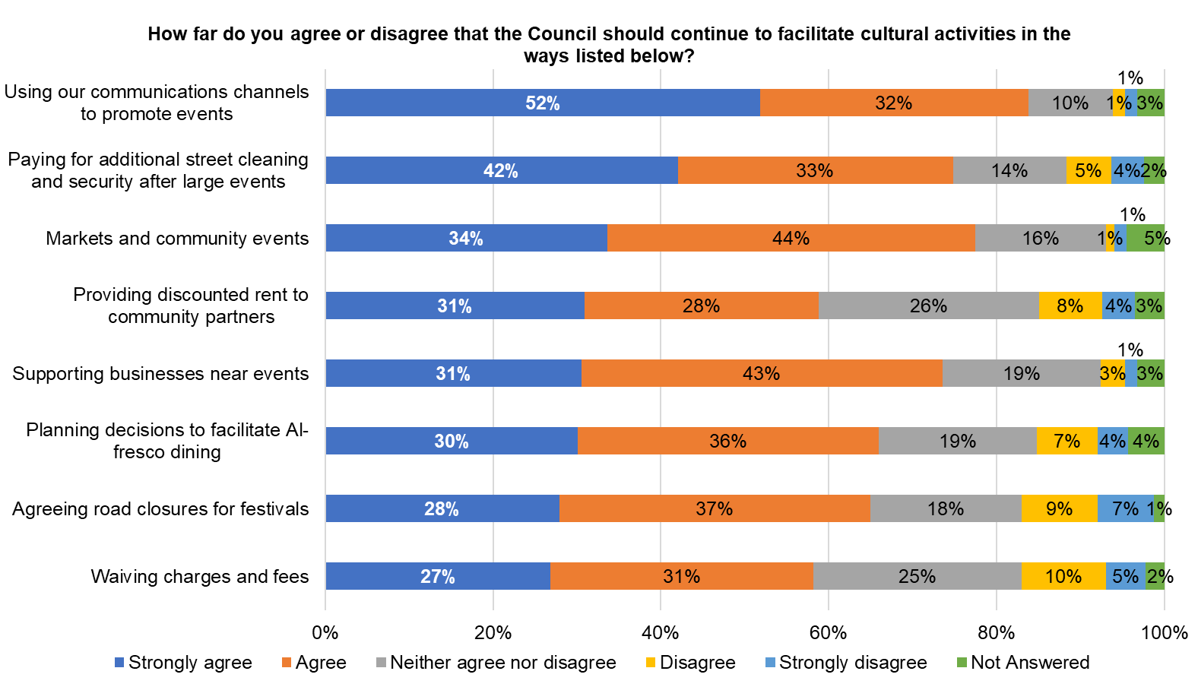
Views on culture
Base: 488 (all responses)

Slide 16
Council’s role in facilitating cultural activities
Respondents were asked how far they agreed or disagreed that the Council should continue to facilitate cultural activities in certain ways.
The highest levels of agreement are for the Council using its communications channels to promote events, with 52 per cent strongly agreeing and 32 per cent agreeing. This is followed by markets and community events (34 per cent strongly agree and 44 per cent agree), paying for additional street cleaning and security after large events (42 per cent strongly agree and 33 per cent agree), supporting businesses near events (31 per cent strongly agree and 43 per cent agree), and planning decisions to facilitate al‑fresco dining (30 per cent strongly agree and 36 per cent agree).
Across the activities, between 10 per cent and 26 per cent of respondents neither agree nor disagree, and between one per cent and 10 per cent disagree or strongly disagree. A graph with the full results can be found on the next page.
Demographic differences (these percentages are strongly agree/agree combined)
Age: Respondents aged under 60 were more likely than those aged 60 and over to agree with several statements. This includes waiving charges and fees (61 per cent compared with 55 per cent), markets and community events (83 per cent compared with 73 per cent), supporting businesses near events (78 per cent compared with 69 per cent), and providing discounted rent to community partners (65 per cent compared with 54 per cent).
Ethnicity: Ethnically Diverse respondents were more likely than White respondents to agree that the Council should waive charges and fees (68 per cent compared with 55 per cent) and provide discounted rent to community partners (77 per cent compared with 54 per cent). They were also more likely to agree that the Council should use its communications channels to promote events (94 per cent compared with 81 per cent).
Location: Respondents living in the north were more likely than those in the centre and south to agree that the Council should provide discounted rent to community partners (68 per cent compared with 50 per cent in the centre and 55 per cent in the south). Those in the north were also more likely to agree with road closures for festivals (67 per cent compared with 63 per cent in the centre and 58 per cent in the south) and with paying for additional street cleaning and security after large events (80 per cent compared with 71 per cent in the centre and 69 per cent in the south).

Slide 17
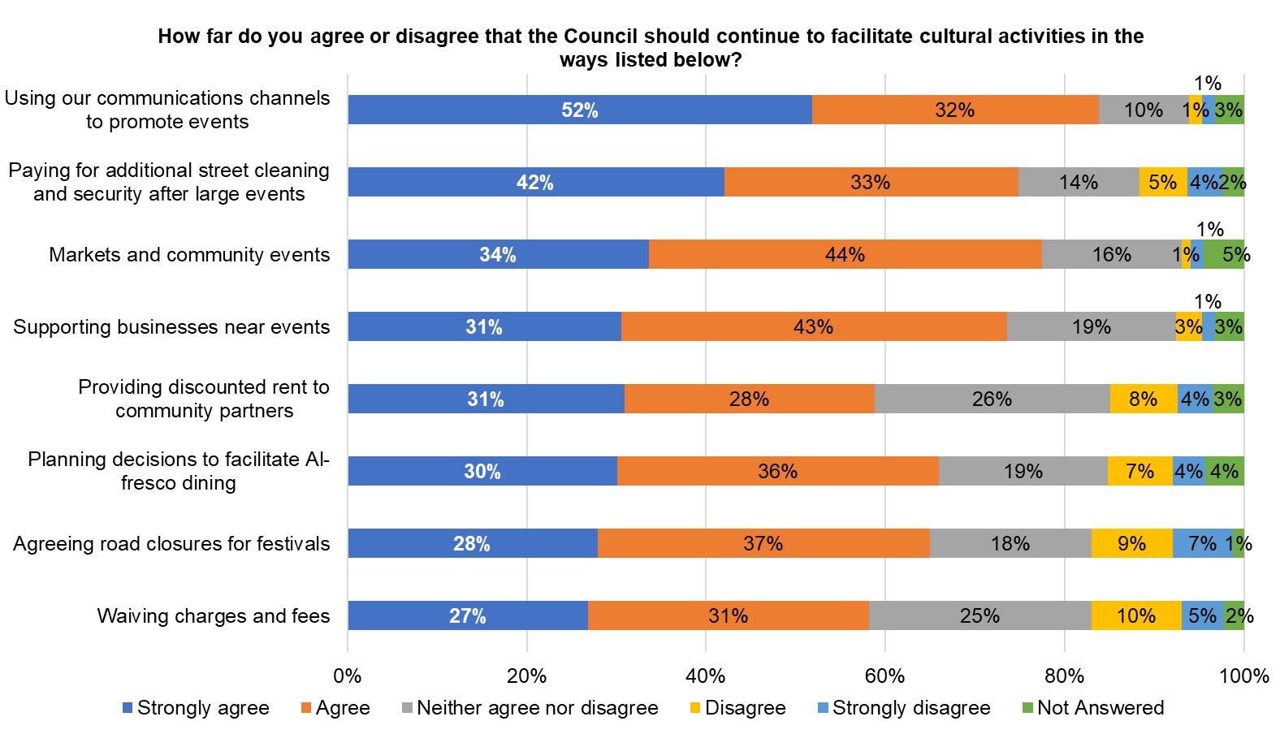
Council’s role in facilitating cultural activities

Slide 18
Providing support to deliver cultural activities
Respondents were asked what more they think the Council could do to support community, public and private partners to deliver cultural activities. A total of 266 people provided responses. These comments have been grouped into key themes, which are summarised in the table below. Examples of individual comments are included on the next page, with the full list of comments available in the final appendices report.
Theme | Count
Promotion, Accessibility, and Inclusivity of Cultural Activities: Improving promotion, publicity, communication channels, and ensuring cultural activities are accessible and inclusive for diverse groups including disabled, elderly, and youth to increase awareness, participation, and community engagement. | 91
Council Funding, Partnerships, and Economic Considerations: Strong support for increased Council funding, financial aid, and partnerships with private sector, schools, and local businesses to sustain, grow, and enhance cultural activities, balanced with caution about endorsing specific activities. | 86
Concerns and Opposition Regarding Council Role, Event Safety, and Spending Priorities: Dissatisfaction with specific events, concerns about safety, financial burdens, council spending priorities, and desire for reduced council involvement in cultural activities, including addressing health and policing issues. | 46
Encouragement of Cultural Innovation, Diversity, and Participatory Arts: Encouraging diverse, thematic, modern cultural programming, participatory arts, and embracing innovation and technology to enrich the cultural landscape and support specific cultural initiatives. | 31
Provision, Management, and Quality of Venues and Events: Providing more and improved venues, maintaining high event quality, managing safety, cleanliness, and minimising negative impacts on local infrastructure and communities are key concerns for supporting cultural activities. | 28
Uncertainty, Lack of Opinion, and Technical Issues in Feedback: Respondents expressing uncertainty, lack of opinion, or experiencing technical difficulties in providing feedback on Council support for cultural activities. | 21
Positive Support for Cultural Vibrancy in the Community: General positive sentiment towards fostering a vibrant cultural focus in the community, indicating support for cultural activities. | 13

Slide 19

Providing support to deliver cultural activities
“To make residents aware of all cultural activities and events. I have no idea what and when events are taking place.”
Promotion, Accessibility, and Inclusivity of Cultural Activities
“Dedicate every year to different types of events under a theme.”
Encouragement of Cultural Innovation, Diversity, and Participatory Arts
“Bring back the likes of the inn on the green where local musicians would regularly play and the Community could eat and drink without having to pay a fortune whilst supporting local events.”
Council Funding, Partnerships, and Economic Considerations
“Facilitate open air areas in the borough, Holland park has plenty of space but there is nothing free for the public there, there are so many areas where the council can organise events.”
Provision, Management, and Quality of Venues and Events
“Keep all libraries open/revert to previous opening times.
No other intervention needed; there are severe budget pressures within the council and council tax is already very high. No need to spend more.”
Concerns and Opposition Regarding Council Role, Event Safety, and Spending Priorities
“I think the Council already does a huge amount to support cultural activities in the Borough. There's a limit to what they can do, given how many other responsibilities they have.”
Positive Support for Cultural Vibrancy in the Community

Slide 20
Value of cultural services
Respondents were asked if they have heard of a series of cultural services funded by Kensington and Chelsea Council and how much they value them.
The most valued cultural services are Kensington Central Library and Portobello Road Market, both valued by 80 per cent of respondents (Kensington Central Library: 61 per cent value a lot and 19 per cent value a little and Portobello Road Market: 58 per cent value a lot and 22 per cent value a little). Leighton House is valued by 69 per cent of respondents (51 per cent value a lot and 18 per cent value a little), followed by Chelsea Library at 64 per cent (47 per cent value a lot and 17 per cent value a little) and Brompton Library at 60 per cent (36 per cent value a lot and 24 per cent value a little).
Lower overall levels of value are reported for Sambourne House, valued by 47 per cent of respondents (31 per cent value a lot and 16 per cent value a little), Kensal Library at 41 per cent (28 per cent value a lot and 13 per cent value a little), and World’s End Community Market at 38 per cent (21 per cent value a lot and 17 per cent value a little).
A relatively high proportion of respondents report not having heard of some services, particularly the London Music Hub (35 per cent), City Living Local Life (27 per cent) and Sambourne House (21 per cent).
A graph with the full results can be found on the next page.

Slide 21
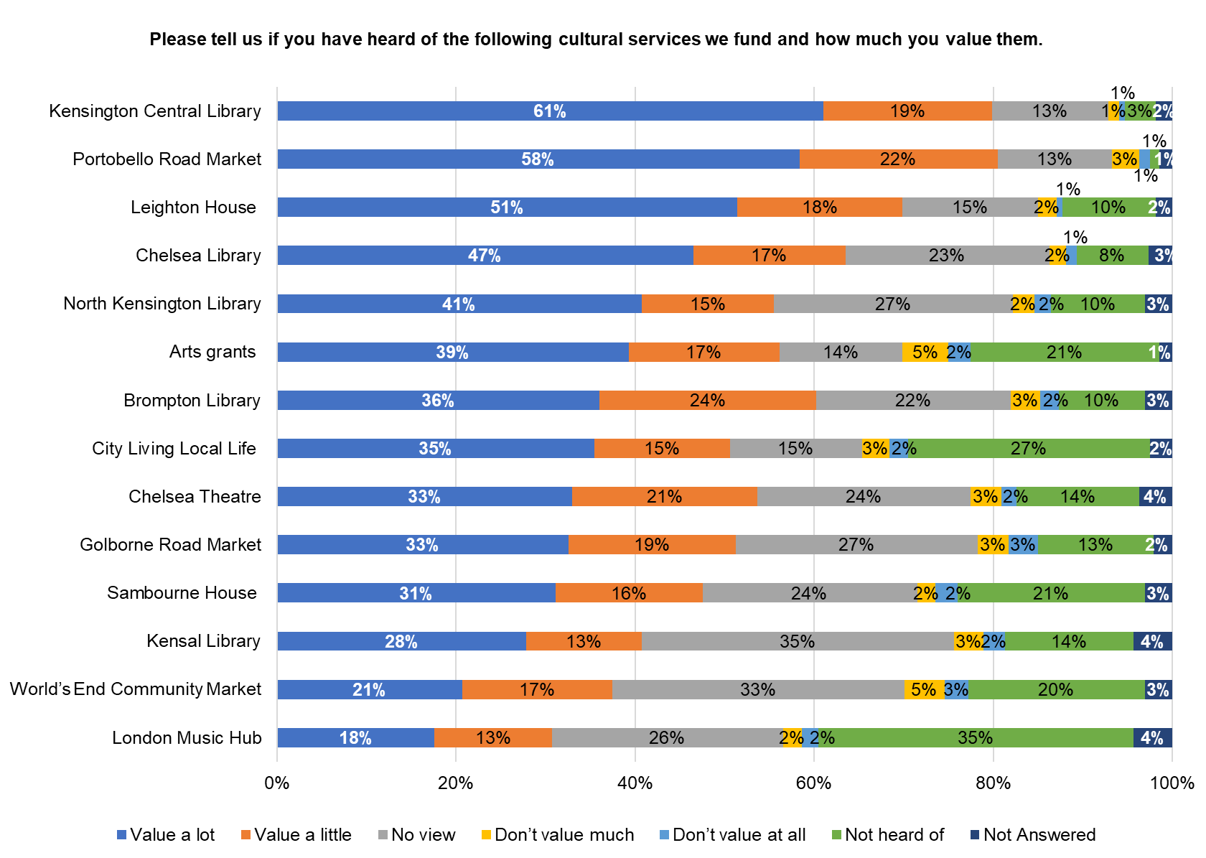
Value of cultural services

Slide 22
Prioritising cultural activities
Respondents were asked if in the future the Council is unable to provide the full range of cultural activities we currently support, what would they prioritise. A total of 364 people provided responses. These comments have been grouped into key themes, which are summarised in the table below. Examples of individual comments are included on the next page, with the full list of comments available in the final appendices report.
Theme | Count
Council run services including Libraries, Parks and Museums | 151
Community and Grassroots Cultural Activities: Community-led initiatives, local markets, festivals, and events that foster social cohesion, cultural diversity, local economic benefits, and community wellbeing. | 136
Cultural Venues, Institutions, and Arts: Heritage sites, art institutions, performing arts, theatre, music, creative workshops, and outdoor public art initiatives are essential cultural resources that enrich education, community engagement, historical significance, and overall cultural life. | 127
Funding, Sustainability, and Prioritisation Concerns: Addressing concerns about funding allocation, sustainability, cost-effectiveness, and differing views on prioritisation and tax implications for cultural activities. | 48
Inclusivity, Accessibility, and Safety in Cultural Activities: Ensuring cultural activities are inclusive, accessible, safe, and supportive of vulnerable groups to promote equitable participation across the community. | 24
Youth and Children’s Cultural Engagement: Prioritising cultural activities targeting youth and children to support their development and engagement in the community. | 19
Health and Social Benefits of Cultural Programs: Cultural programs that promote health, well-being, reduce social isolation, and build social cohesion as important community priorities. | 18
Uncertainty or Lack of Opinion: Respondents expressing uncertainty or lack of opinion. | 12
Localised Decision-Making for Cultural Priorities: Emphasising the need for cultural activity prioritisation to be localised based on specific community needs and preferences. | 11

Slide 23

Prioritising cultural activities
“Libraries, museums, parks, gardens, music.”
Council run services including Libraries, Parks and Museums
“Prioritise safety of all events. Prioritise those which reach the largest number for the least outlay. Prioritise events which enable older and less able residents to enjoy, perhaps arranging transport.”
Inclusivity, Accessibility, and Safety in Cultural Activities
“Community inspired cultural events..”
Community and Grassroots Cultural Activities
“I will prioritise open air events where residents of the borough can gather during the weekends. Events including music, dance etc...”
Cultural Venues, Institutions, and Arts
“Unique creative activities, different from what people could get elsewhere. Things to help children learn to appreciate art/culture are important.”
Youth and Children’s Cultural Engagement
“The council should not jeopardise Council Tax Payers buy increasing the level of tax, only if surplus funds are available should money be provided for the 'non-essential' cultural activities. It appears that there is a considerable waste of Council funds with prioritising needless entertainment.”
Funding, Sustainability, and Prioritisation Concerns
“Prioritise cultural programs that are proven to improve health and well-being, build social cohesion, and reduce social isolation.”
Health and Social Benefits of Cultural Programs
“See which cultural activities is/are more important to the area.”
Localised Decision-Making for Cultural Priorities

Slide 24
Value added by cultural services
Respondents were asked how far they agreed or disagreed with three statements.
The highest levels of agreement are for the statements that cultural activities can bring different communities together to support community cohesion, with 53 per cent strongly agreeing and 28 per cent agreeing, and that cultural activities can help people meet others from different backgrounds and support an inclusive environment, with 52 per cent strongly agreeing and 29 per cent agreeing.
The lowest levels of agreement is for the statement “Culture in the borough adds enjoyment to my life”, where 26 per cent strongly agree and 31 per cent agree. This statement also has a higher proportion of respondents who neither agree nor disagree (32 per cent), compared with the other statements. A graph with the full results can be found on the next page.
Demographic differences (these percentages arestrongly agree/agree combined)
Age: Respondents aged under 60 were more likely than those aged 60 and over to agree that cultural activities can bring different communities together to support community cohesion (86 per cent compared with 76 per cent).
Ethnicity: Ethnically Diverse respondents were more likely than White respondents to agree that cultural activities can bring different communities together to support community cohesion (91 per cent compared with 79 per cent). They were also more likely to agree that cultural activities can help people meet others from different backgrounds and support an inclusive environment (95 per cent compared with 78 per cent), and that the current range of community activities in the borough supports effective community cohesion (68 per cent compared with 55 per cent).
Location: Respondents living in the north and centre of the borough were more likely than those in the south to agree that cultural activities can bring different communities together to support community cohesion (north 83 per cent, centre 82 per cent, south 73 per cent). Those in the north and centre were also more likely to agree that the current range of community activities supports effective community cohesion (north 57 per cent, centre 60 per cent, south 46 per cent).

Slide 25
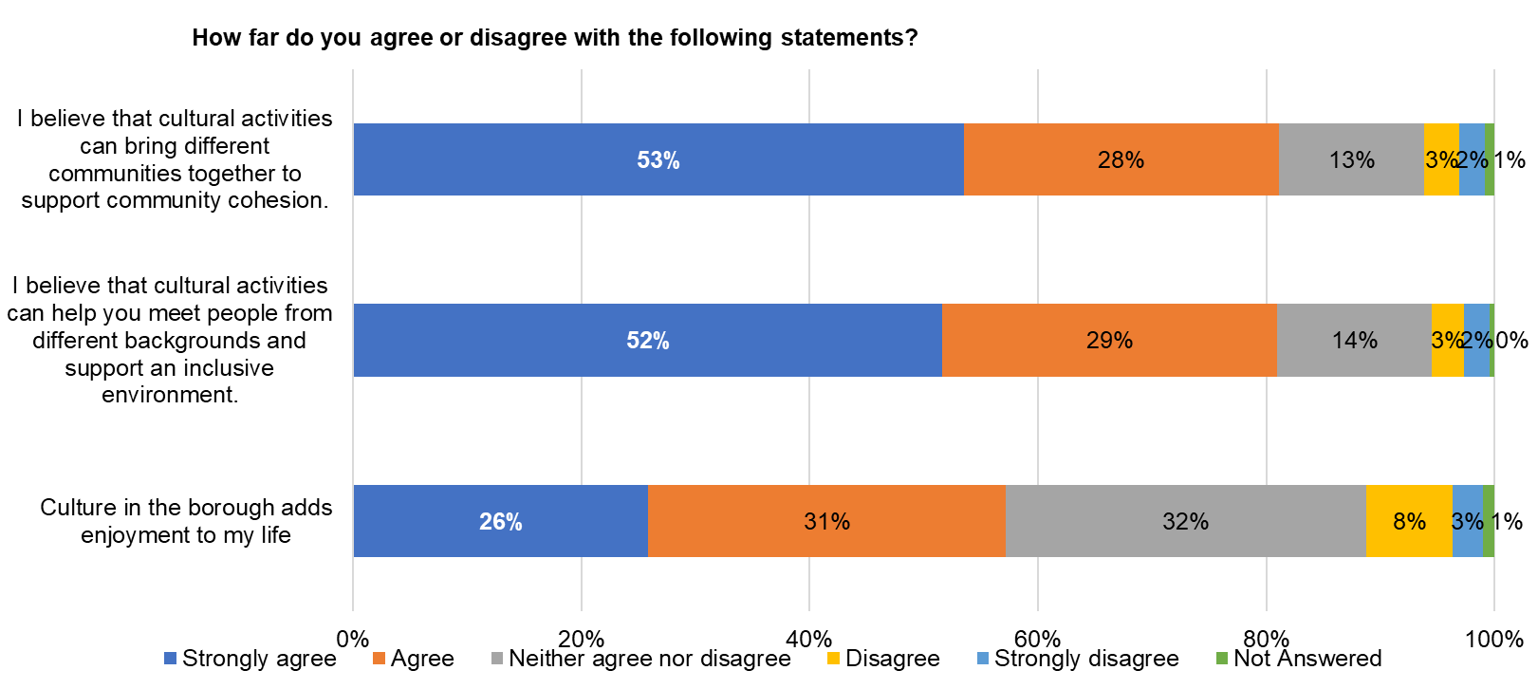
Value added by cultural services
Base: 488 (all responses)

Slide 26
Supporting community cohesion
Respondents were asked what more they think the Council can do through cultural actives to support community cohesion. A total of 241 people provided responses. These comments have been grouped into key themes, which are summarised in the table below. Examples of individual comments are included on the next page, with the full list of comments available in the final appendices report.
Theme | Count
Inclusive and Diverse Cultural Programming: Cultural activities should be inclusive, accessible, and representative of the borough's diverse communities, featuring a wide range of events and trauma-informed programming to foster shared experiences and community spirit. | 51
Scepticism of Council's Role and Cultural Activities: Residents question if this is something the Council should be focusing on at all, doubts exist about the effectiveness of cultural activities and if they cause more separation, funding priorities, community willingness to engage, and limited awareness or uncertainty about cultural offerings. | 40
Promotion, Communication, and Awareness: Effective marketing, professional promotion, and widespread communication are essential to raise awareness and encourage community participation in cultural activities. | 40
Social and Collaborative Activities for Community Cohesion and Safety: Activities promoting positive interaction, collaboration, social gatherings, and addressing safety and anti-discrimination efforts are foundational for building community spirit and cohesion. | 38
Community Involvement and Use of Local Spaces: Active resident involvement in planning and organising cultural activities, supported by community-led initiatives and use of public and unique local spaces, ensures activities reflect community needs and enhance cohesion. | 37
Council Support and Funding for Cultural Activities: Residents emphasise the need for transparent, increased, and equitable financial and practical support from the council for diverse cultural activities, including support for emerging artists and community collaborations. | 36
Uncertainty, Lack of Opinion or have provided comments in previous answers: Respondents expressing uncertainty or lack of opinion. | 29
Youth Engagement and Intergenerational Programs: Engaging young people through arts education, youth-led initiatives, and intergenerational programs promotes diversity and community cohesion from an early age. | 15
Geographical Connectivity and Bridging Cultural Resources: Bridging cultural resources and investments across different borough areas is necessary to create a unified cultural landscape and encourage broader community cohesion. | 10

Slide 27
Supporting community cohesion
“Have mini versions of events touring different parts of the borough to showcase different cultures.”
Inclusive and Diverse Cultural Programming
“Perhaps use community volunteers to help generate ideas and help organise. It might reduce stress on your staffing.”
Community Involvement and Use of Local Spaces
“Nothing. People mix organically anyway. There is no need to allocate budget here.”
Scepticism of Council's Role and Cultural Activities
“Give people the money they need to put on the events that they wish to.”
Council Support and Funding for Cultural Activities
“Ensure messages/newsletters promote inclusivity as well as the actual event.”
Promotion, Communication, and Awareness
“Focus on young people through accessible cultural projects and spaces that help them feel part of the community (especially as many youth clubs have closed).”
Youth Engagement and Intergenerational Programs
“Culturally safe venues and outreach that engage residents where they are, such as faith spaces, housing estates, and schools, to ensure that activities are co-designed with community members.”
Social and Collaborative Activities for Community Cohesion and Safety
“Try to break down the north/south divide and move cultural activities around the borough.”
Geographical Connectivity and Bridging Cultural Resources

Slide 28
Demographics of survey respondents

Slide 29
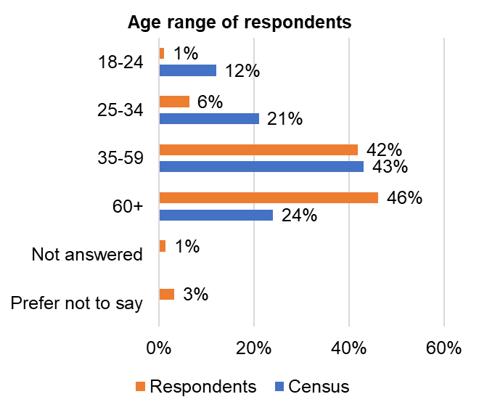
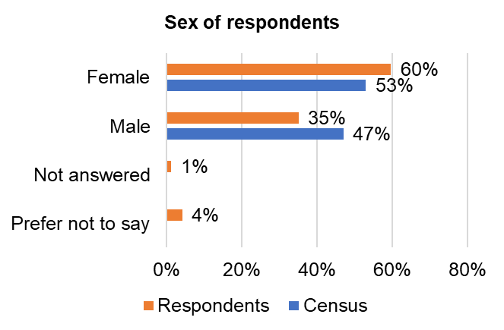
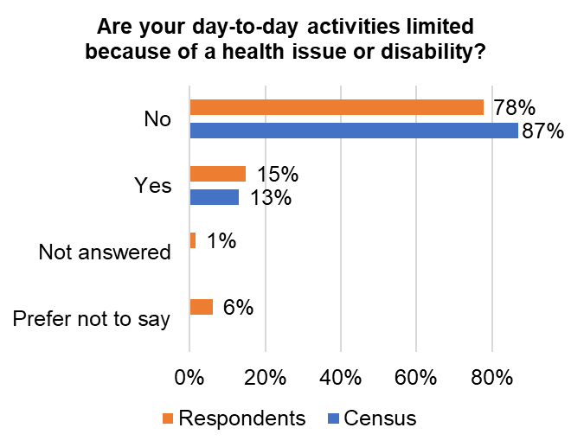
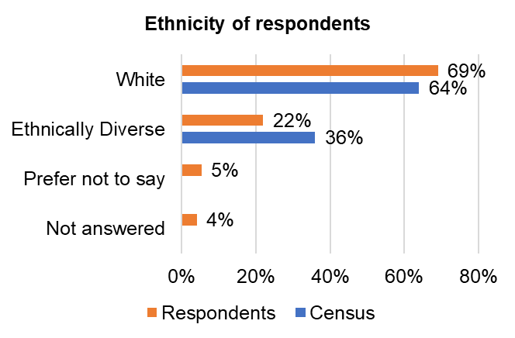
Demographic profile of respondents
Base: 488 (all responses)

Slide 30
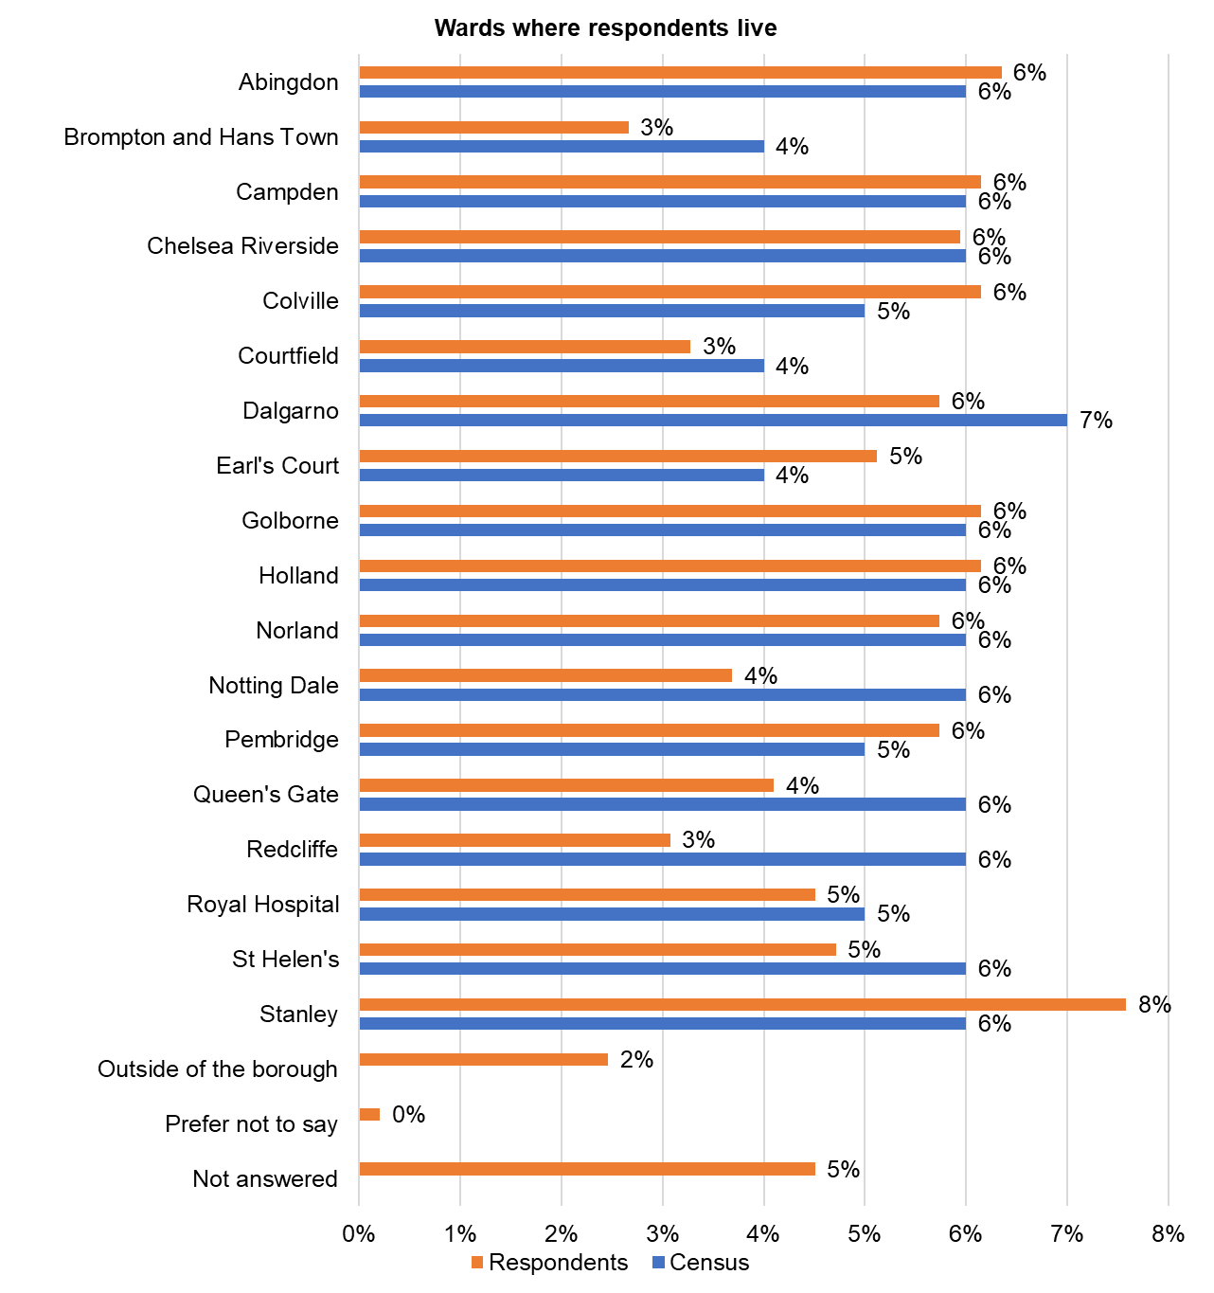
Demographic profile of respondents
Base: 488 (all responses)

Slide 31
Culture and Creative Sector Workshops October 2025

Slide 32
Culture and Creative Sector Workshops
Purpose of workshops
For the culture and creative sector to input into the development our new Culture Plan
To understand their priorities for the next three years
To hear their thoughts on how we best work together to ensure all residents have access to the borough’s rich culture
Schedule
Three 90-minute sessions on MS Teams
Workshop 1: Mon 13 October, 5-6:30pm (evening)
Workshop 2: Thu 16 October, 9:30-11am (morning)
Workshop 3: Tue 21 October, 3:-4:30pm (afternoon)
Workshops at a glance
76 attendees across 3 workshops
68 unique attendees
43 organisations
13 artists
2 other
Workshop 1
28 attendees
16 organisations
7 artists
1 other
Workshop 2
23 attendees
16 organisations
3 artists
1 other
Workshop 3
25 attendees
15 organisations
6 artists
1 other

Slide 33
What are the culture and creative sector priorities over the next three years?
Fostering youth engagement in culture sector
Invest in young people as future cultural contributors through cultural education and opportunities, like mentorship programmes.
Support young people from deprived backgrounds to access cultural careers through vocational pathways, including training, mentorship, and work experience opportunities.
Greater collaboration with schools to integrate cultural activities. Ideas like “10 by 10” (Hackney) or “11 by 11” (Islington) initiatives to ensure children experience culture early.
Supporting grassroots culture providers and artists:
Support for marginalised and underrepresented artists and organisations.
Enable local artists and smaller local groups to access space, funding, and visibility with in-kind support, pop-up spaces, and artist directories.
Opportunities for artists to create and showcase work.
Ensure grassroots and artists representation in policy-making and festival leadership.
Ensuring accessibility and inclusion
Breaking down barriers to cultural institutions, especially for marginalised communities, with outreach and better promotion of cultural venues.
Addressing physical and social barriers to participation.
Integrate arts into statutory spaces like libraries and museums to reach wider audiences
Highlighting free and welcoming cultural offers.
Public realm improvements: Enhancing walkability and connectivity between cultural sites.
Better understanding of resident engagement and cultural impact
Addressing disparities in cultural engagement between north and south of the borough.
4. Linking culture to health and wellbeing outcomes
Recognition of the role of culture and the arts in mental health and social cohesion.
Align the Culture Plan with health strategies and explore creative health/social prescribing.

Slide 34
What are the culture and creative sector priorities over the next three years?
5. Encouraging cross-sector collaborations and networking
Ongoing forums, stakeholder advisory groups, and cultural conversations.
Collaborations between large institutions and smaller organisations and artists.
Cross-borough and international partnerships to raise the profile of RBKC’s cultural offer.
Encourage co-production and shared resources across the sector.
Improve communication and feedback mechanisms with local artists and organisations.
6. Improving venue access and visibility of cultural offer
Better wayfinding signage to increase numbers of visitors to venues and attractions.
Opening up existing venues (e.g., libraries, studios, community centres) for performances and exhibitions and activating underused spaces for community-led cultural events.
Creating a network of performance and exhibition spaces.
Ideas like “Open House Artist Studio Days” and “Hosting Heroes” to democratise access.
Ensure new developments include affordable cultural workspaces.
7. Supporting festivals
Strengthening existing festivals (e.g. Chelsea Arts Festival, Kensington & Chelsea Art Week).
A borough-wide cultural season or umbrella branding to unify efforts.
8. Organisational Capacity Building
Peer to peer mentoring, and capacity building for smaller, local groups.
Need for financial and governance training for small cultural organisations. Council could offer masterclasses or advisory support.
Emphasis on cultural competency and recognising the borough’s diverse communities.

Slide 35
Given the financial context, how does the sector think the Council can best support achievement of these priorities?
Convener and connector
Facilitate networking, share contact databases, host quarterly cultural conversations.
Enabler
Improve licensing processes, offer real-time “What’s On” platforms, and streamline event permissions and support. In-kind support (e.g. venues, promotion, coordination) as a key Council contribution.
Promoter and communicator
Use Council channels to amplify cultural events and initiatives. Promote borough-wide cultural activities via a centralised “what’s on” platform.
Innovator
Explore crowdfunding platforms (e.g. Milan model), sponsorships, and blockchain-based ticketing/data systems.
Supporter
Provide in-kind support, small grants (when possible), and help with sponsorship and fundraising.

Slide 36
How can we work better together to increase resident access to culture in all its forms in the borough?
• Cross-sector partnerships (e.g. museums, schools, artists working together on programmes and initiatives).
• Regular stakeholder meetings or forums (possibly reviving “Cultural Conversations”) and newsletters to connect the sector.
• Shared online portal for opportunities and contacts.
• Peer to peer support across the sector for governance and financial management for small organisations.
• Borough-wide cultural audits to uncover hidden resources.
• Prioritise local artists in commissioning and festival planning.
• Linking culture with health, education, and wellbeing.
• “Cross-fertilisation” programming (e.g. linking science and art) and shared programmes.
• Shared infrastructure and resources to reduce costs and increase impact.
• Equitable partnerships and anti-gatekeeping practices
• Institutions like the Natural History Museum, Science Museum, English National Ballet, and local grassroots organisations expressed openness to:
o Joint programming.
o Artist residencies.
o Shared outreach to underserved communities.
o Co-hosted events and festivals.

Slide 37
Other matters discussed
Alternative Funding Models
Funds raised from s106 used to support creative development, covering a wide remit including professional and community arts, arts participation and commissions.
Open up Section 106 funds to include non-physical art forms like poetry and performance.
“RBKC Angels” – a charitable arm to attract donations from wealthy residents/local philanthropists supporting culture.
Tourism tax and other creative funding mechanisms.
Create a sinking fund to smooth out “feast or famine” funding cycles.
Leverage RBKC’s cultural assets to attract visitors and boost local economy to reinvest back into culture.
Ideas for Low-Cost, High Impact Actions
Youth Cultural Ambassadors: Involve young people directly in planning and events.
Crowdfunding Platform: Inspired by Milan’s model – Council matches funds raised by local projects.
Shared directory and contact list: Facilitate collaboration by sharing stakeholder contacts.
Digital infrastructure: Use AI and digital tools to simplify event planning and promotion.
Embassy and private sector engagement: Explore sponsorships and international partnerships.

Slide 38
Discussion with members of Action Disability Kensington and Chelsea (ADKC) 27 October 2025

Slide 39
Session Overview
This session, with eight members of Action Disability Kensington and Chelsea (ADKC), was held as an opportunity for residents to engage with the consultation survey in a different format.
The questions asked in the survey were shared with attendees and they were given the space to share their thoughts and views in a way that felt most comfortable to them. The three questions the group decided to focus on were around supporting partners to deliver events, supporting community cohesion and improving overall experiences.
The notes taken from these discussions are included on this and the following pages.
Q1. What more do you think the Council could do to support community, public and private partners to deliver cultural activities?
Develop and promote a list of accessible activities through the Council website.
Services for disabled residents are not always clearly communicated — improve how information is shared and ensure accessibility details are easy to find.
Q2. What more do you think the Council can do through cultural activities to support community cohesion?
Shared Spaces and Inclusion
Create more shared spaces and accessible courses to help disabled residents get involved and share their talents.
Strengthen collaboration with organisations such as ADKC to reach more residents.
Offer inclusive community activities such as cooking classes, yoga, art, and crafts.
Representation and Involvement
Establish accessible forums or dedicated consultation groups to regularly involve disabled residents in shaping Council services.
Ensure their voices are included in service design and decision-making.

Slide 40
Q3. What one thing could the Council and its partners do to improve your experience of cultural activities in the borough?
Accessibility for Children and Families
Consider the specific needs of disabled children and ensure activities are suitable for them.
Many temporary exhibitions are not free or accessible; even when they are, they can be overcrowded. Provide quieter, more inclusive cultural opportunities, particularly for disabled children.
Include quiet time programming in libraries.
Mobility and Comfort
Introduce a borough-wide disability card to make it easier for disabled residents to access services and venues.
Improve accessibility for children using manual or powered wheelchairs — provide cushions or blankets during colder months.
Provide rest areas in parks and open spaces for people who need breaks.
Ensure proper lighting for visually impaired residents.
Increase the number of disabled parking bays and drop-off points.
Information and Technology
Use the Welcome App with up-to-date information on disability accessibility and inclusive events across the borough.
Events and Accessibility
Provide additional support for disabled residents during large public events.
Consider al fresco dining and similar outdoor activities, ensuring accessibility for wheelchair users.
Road closures during events can make access difficult for disabled residents and families — plan with accessibility in mind and treat it as a priority.
Increase the number of disabled performance spaces and improve accessibility to cultural venues.
Work closely with ADKC and disabled residents to co-produce events and ensure their needs are embedded in policies and strategies.
Prioritise accessible, inclusive, and diversity-focused events that celebrate all communities and create positive change.

Slide 41
Citizens’ Panel Event 19 November 2025

Slide 42
Session Overview
Attendees: 97 residents from the Citizens’ Panel with representation from across the borough
Location: In person at the Great Hall, Kensington Town Hall
The event began with a short presentation outlining the Council’s current financial challenges, followed by table-top discussions facilitated by Council Officers.
The second half of the event focused specifically on cultural activities, exploring their value for Panel members, the role of the Council in supporting and facilitating cultural provision, and priorities for allocating S106 funding, which is ringfenced for cultural purposes.
The session began with a short presentation outlining what constitutes cultural activity, explaining how S106 funding operates, and introducing the Culture Plan currently being drafted as part of this consultation. This was followed by table‑top discussions facilitated by Council Officers, enabling Panel members to share their views, experiences, and priorities in more depth.
Over the next three pages you will see summaries of the feedback from residents for the three question areas covered at the event. A full write up from the event including more detail of the conversations had can be found in the appendix document for this report.

Slide 43
Q1. Value of cultural activities
In what ways do you think residents benefit from cultural activities, and how could we build on these opportunities without increasing costs?
Panel members highlighted that cultural activities provide significant benefits, including community cohesion, education, mental health support, and opportunities for enrichment and participation. They emphasised that cultural events help reduce loneliness, celebrate diversity, and strengthen local identity and heritage. To build on these opportunities without increasing costs, suggestions focused on better promotion and awareness, partnerships with businesses and cultural organisations, sponsorships, and leveraging existing assets such as parks, libraries, and council buildings. Panel members also proposed co-producing events with local communities, increasing volunteering opportunities, and using digital platforms and social media to raise visibility.
Benefits of Cultural Activities
Community cohesion and inclusion
Education and enrichment
Mental health and wellbeing
Economic and tourism impact
Cost-Neutral Ways to Build Opportunities
Better promotion and awareness
Partnerships and sponsorships
Leverage existing assets such as council buildings, libraries, and parks for events
Community-led initiatives: Encourage residents to co-produce events
Partner with researchers, schools, and local organisations to deliver events efficiently and inclusively.
Analyse which events deliver the greatest impact and prioritise those; ensure clarity on funding and costs.

Slide 44
Q2. Council’s role in supporting culture
Given the current financial challenges the borough faces, what role should the Council play in facilitating cultural activities, especially in making them accessible to disadvantaged residents and appealing to visitors?
Residents want the Council to enable, connect, and amplify culture rather than fund everything directly, given current budget constraints. They see the Council’s role as facilitator and convenor: cutting red tape for community-led events, opening up council spaces, improving communications, and targeting support where it has the greatest social impact (especially for disadvantaged residents). To appeal to visitors without neglecting locals, they recommend smarter promotion via hotels and institutions, seasonal programming, and leveraging sponsorships and S106 contributions. Accessibility, transparency (where funding goes and outcomes), and collaboration (with schools, faith groups, Job Centres, and neighbouring boroughs) are recurring priorities.
Themes
Enable community-led culture - Less red tape, educate and mentor groups to run their own activities, allow free or low cost use of council buildings, minimise duplication and provide a clear overview of events.
Accessibility and inclusion - Actions proposed: Ensure events are accessible, prioritise broad, inclusive activities, use religious and community settings for outreach, promote in libraries, GP surgeries, Job Centres and cater for multiple languages.
Communications and promotion - Centralised events listing, social media/newsletters, digital noticeboards, staff email footers, inform hotels/MPs/religious leaders, “lead in curating” without adding cost.
Partnerships and funding - Secure sponsorship (e.g., Christmas lights, Opera Holland Park), engage VIPs/Chelsea FC, link schools with cultural institutions, mix council-led and sponsored programmes, increase S106 cultural contribution and voluntary participant contributions (“social giving”).
Council owned space and night-time economy - Use estates and institutions to host events, rent the Great Hall, seasonal markets/night markets, bring arts into streets and parks.
Governance, transparency and value for money - Calls for: Clearer funding transparency and outcomes, scrap poorly attended council-run activities, better contractor/partner control, avoid duplication and publish an accessible events overview.

Slide 45
Q3. Priorities for Spending S106 Funding
What cultural activities do you think the Council should prioritise when planning how to spend s106 funding?
Panel members emphasised that S106 funding should prioritise cultural activities that are inclusive, accessible, and sustainable, with a strong focus on education, community engagement, and diversity. Key priorities included investment in libraries, cultural hubs, and grassroots organisations, as well as programmes for children, young people, and older residents. Suggestions also highlighted the importance of outdoor spaces, community gardens, and cultural events that celebrate heritage and diversity. Panel members called for better promotion, partnerships with businesses and institutions, and creative use of council-owned spaces to maximise impact. Transparency on how S106 contributions are allocated and ensuring value for money were seen as essential.
Themes
Education and lifelong learning - Libraries, creative writing programmes, health and education projects, Stay and Play centres, Sure Start centres, and workshops introducing arts and culture.
Cultural hubs and venues - Develop cultural hubs or centres, use council spaces such as Town Hall, create certified accessible venues, equivalent of Chelsea Theatre in the north.
Grassroots and community-led activities - Support grassroots organisations like The Muse, facilitate community-led events, cultural befriending programmes for those facing loneliness, co-production with residents.
Children, young people, and families - Trips to museums, cultural activities in youth clubs and schools, music sessions and instruments, pantomimes, family events at low cost.
Older residents and wellbeing - Dance, exercise, theatre trips, and partnerships with organisations like Open Age, activities that promote social interaction and physical health.
Outdoor and public spaces - Use gardens and parks for cultural events, Canalside improvements, light trails in Holland Park, street parties and festivals.
Diversity and heritage - Events celebrating cultural diversity (traditional dances, artwork from different countries), historical education, festivals showcasing multiple cultures.
Transparency and value for money - Clear communication on S106 contributions and outcomes, avoid spending on cleaning and policing carnival, focus on impactful, well-attended activities.

Slide 46
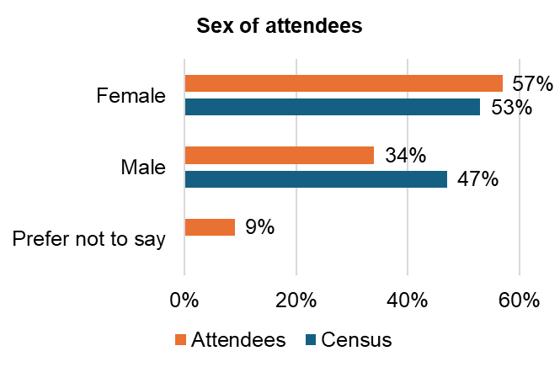
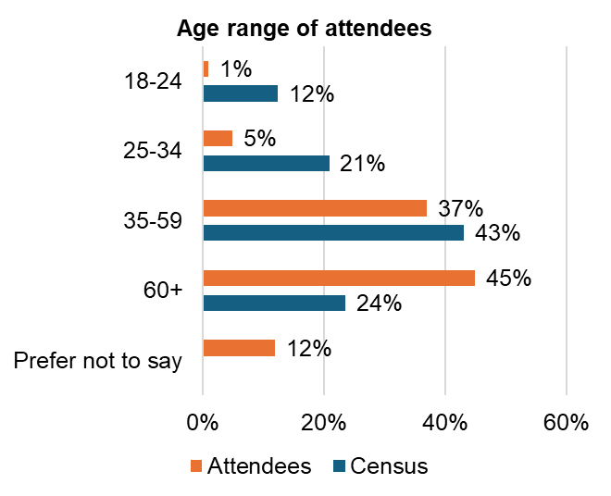
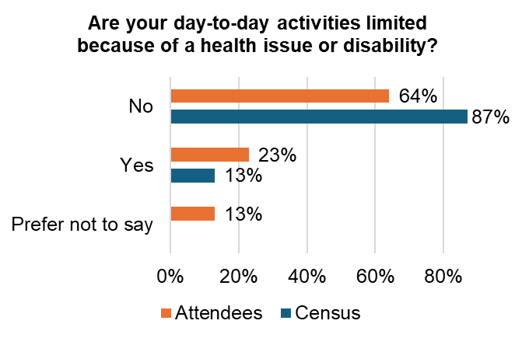
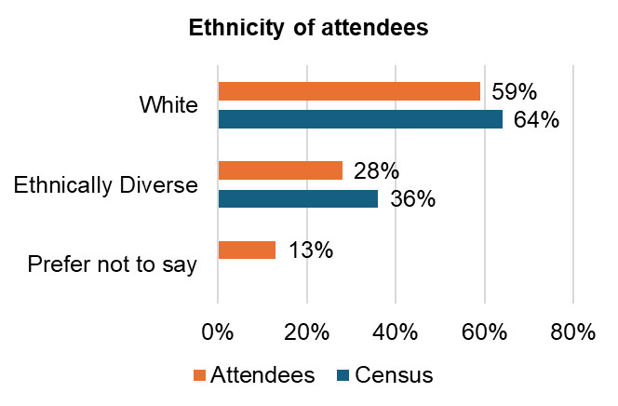
Demographic profile of attendees
Base: 97 (all responses)

Slide 47
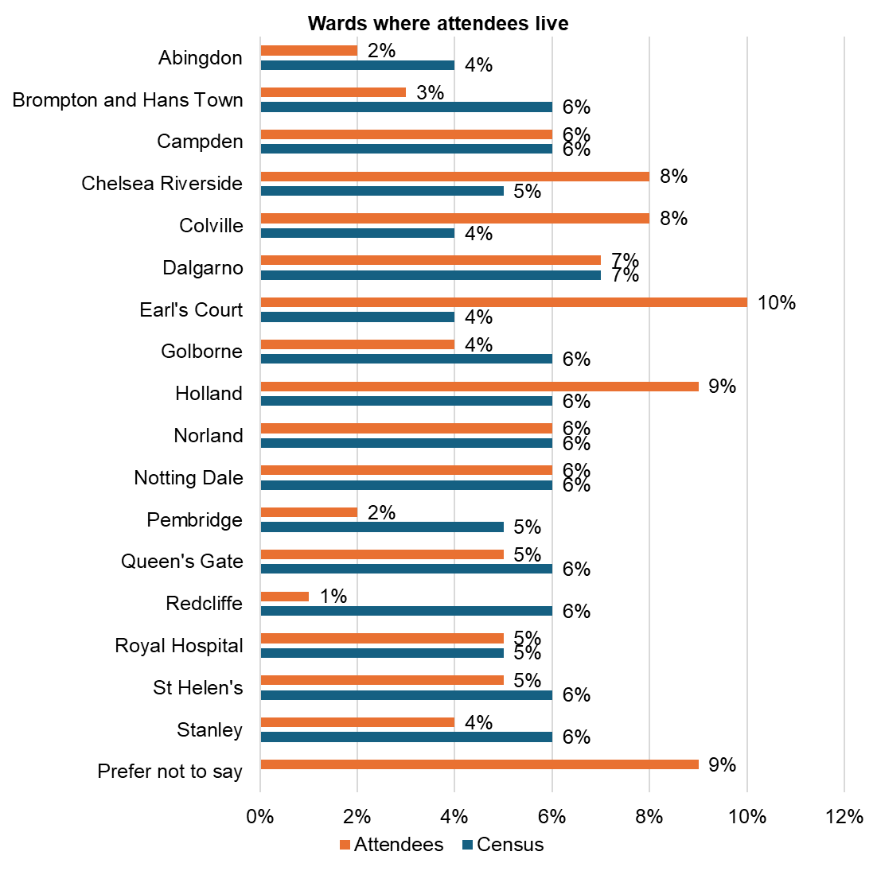
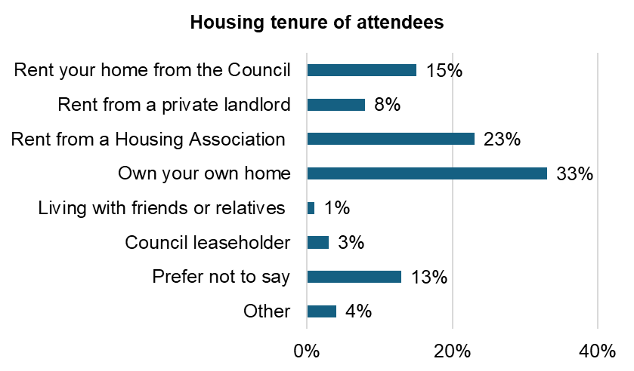
Demographic profile of attendees
Base: 97 (all responses)

Slide 48
Workshop with Kensington and Chelsea’s Youth Council 24 November 2025

Slide 49
Session Overview
In November 2025, the Youth Council took part in a dedicated session to share young people’s views on cultural activities in the borough. A total of 15 members were briefed on the current financial pressures facing cultural services, the role of section 106 (s106) funding, and the development of a new three-year Culture Plan.
The discussion focused on the benefits of culture for young people, priorities in a constrained financial environment, and how the Council can better champion cultural activity.
In this report you will see summaries of the feedback from the Youth Council for the three question areas covered during the session, the benefits of cultural activities, priorties in the context of limited funding and championing cultural activities.
A full write up from the session can be found in the appendix document for this report.
Q1. What are the benefits to young people from all the culture in the borough?
Community connection and belonging
Culture was seen as a powerful way to bring people together, strengthen community bonds and reduce loneliness. Young people highlighted its role in building shared experiences across communities.
Wellbeing, enjoyment and escapism
Cultural activities were valued as opportunities to have fun, relax and escape everyday pressures, supporting mental wellbeing.
Celebration of identity and heritage
Events celebrating Caribbean culture and Carnival were highlighted as positive examples, with a desire to expand opportunities to celebrate a wider range of cultures and heritages.
Dedicated heritage months were seen as valuable but under promoted.
Skills development and creative expression
Cultural workshops and arts activities were viewed as opportunities to develop skills, explore creative passions and engage with culture in practical ways.
Discovery and inspiration
Culture was seen as a way to discover new music, art and creative influences.
Young people expressed interest in partnerships with large cultural organisations to support high quality, community focused events.

Slide 50
Session Overview
Q3. What can the Council do to champion cultural events?
Acting as a connector and promoter
Young people felt the Council should play a stronger role as a communication and coordination hub, helping to connect organisations and promote cultural activity through Council platforms.
Visibility and leadership
The presence of Council officers at cultural events was seen as an important way to demonstrate commitment and visibly champion culture.
Inclusive and representative programming
Young people stressed the importance of inclusive cultural events, including consideration of dietary requirements and better representation of smaller or less well‑known countries and cultures.
Embedding culture in everyday settings
Schools were identified as key spaces for cultural engagement, with opportunities to strengthen links between cultural activity and primary and secondary education.
Q2. What should be prioritised if funding is limited?
Accessibility and inclusion
Ensuring cultural events are accessible to disabled young people was a key priority, including physical access, transport costs and access to information for those not using social media or smartphones.
Clear communication and coordination
Young people highlighted the need for better information sharing and promotion to avoid duplication of events and ensure awareness of what is available across the borough.
Safeguarding
Safeguarding was identified as a fundamental priority when planning and delivering cultural activities, particularly for young people.
Celebrating local heritage
Ideas such as cultural heritage plaques or trails were suggested as ways to recognise and showcase the borough’s diverse histories.

